Slide 1
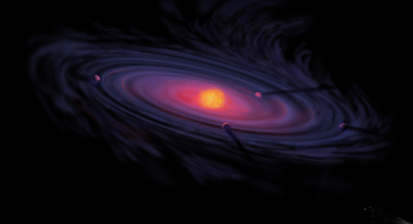
Origins of Gas Giant Compositions: The Role of Disk Location and Dynamics
Ana-Maria Piso
Thesis Defense: April 27th, 2016

Slide 2
Minimum Core Masses for Giant Planet Formation

Slide 3
Analytic non-self gravitating model predicts lower L and larger t_{run}
Self-gravity matters when M_{atm} only few percent of M_{c}
Piso & Youdin (2014)
Notes:
MAYBE

Slide 4
Atmospheric growth time is slowest before mass doubling
Piso & Youdin (2014)
t_{run} = 10% of t_{growth, max}

Slide 5
Neglected luminosity and surface terms in energy equation non-negligible only AFTER time of slowest growth
Piso & Youdin (2014)

Slide 6
Variations in the adiabatic gradient affect atmospheric L and dE/dM
M_{dot} = L / (-dE/dM)
Low T EOS => L decreases
High T EOS => -dE/dM increases
Piso, Youdin, Murray-Clay (2015)
Piso, Youdin, Murray-Clay (2015)

Slide 7
Snowlines and C/N/O Ratios

Slide 8
Radial drift affects snowline location
Piso, Oberg, Birnstiel, Murray-Clay (2015)

Slide 9
Desorption almost instantaneous and in a narrow distance range
Piso, Oberg, Birnstiel, Murray-Clay (2015)

Slide 10
The desorption distance for transition disks agrees with observations
Piso, Oberg, Birnstiel, Murray-Clay (2015)
Notes:
Cite TWHya paper

Slide 11
N/O ratios more enhanced than C/O ratios
Piso, Pegues, Oberg (2016)

Slide 12
C/N/O Model Extensions and Preliminary Results

Slide 13
GOAL
Calculate C/N/O ratios self-consistently in active disks => include time dependence
Explore how diffusion across the snowlines affects the snowline locations and the C/N/O ratios
Piso, Oberg, Birnstiel, Murray-Clay (2015) (2015)
Notes:
Show C/O plot again with arrows

Slide 14
BASIC IDEA
Treat each volatile in gaseous and solid form as two fluids that are interchanging and use advection-like equations to solve for their separate time-dependent abundance

Slide 15
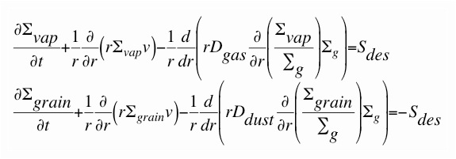
Basic Equations
Σ_{vap}, Σ_{grain} = surface densities of volatiles in gas and solid form
Σ_{g} = surface density of nebular gas
v = gas radial velocity
D_{gas} = gas diffusivity = viscosity
D_{dust} = dust diffusivity = D_{gas} / (1 + St^2)
S_{des} = source function of desorbed ices = f(Σ_{grain}, r, s, volatile properties)
Ciesla & Cuzzi (2006), Birnstiel et al. (2010, 2012)

Slide 16
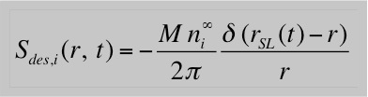
Preliminary Results 1: Steady-State Disk
(Owen+14)

Slide 17
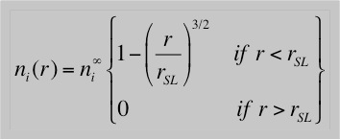
Preliminary Results 1: Steady-State Disk
(Owen+14)

Slide 18
Gas-phase C/O ratio in steady state disk

Slide 19
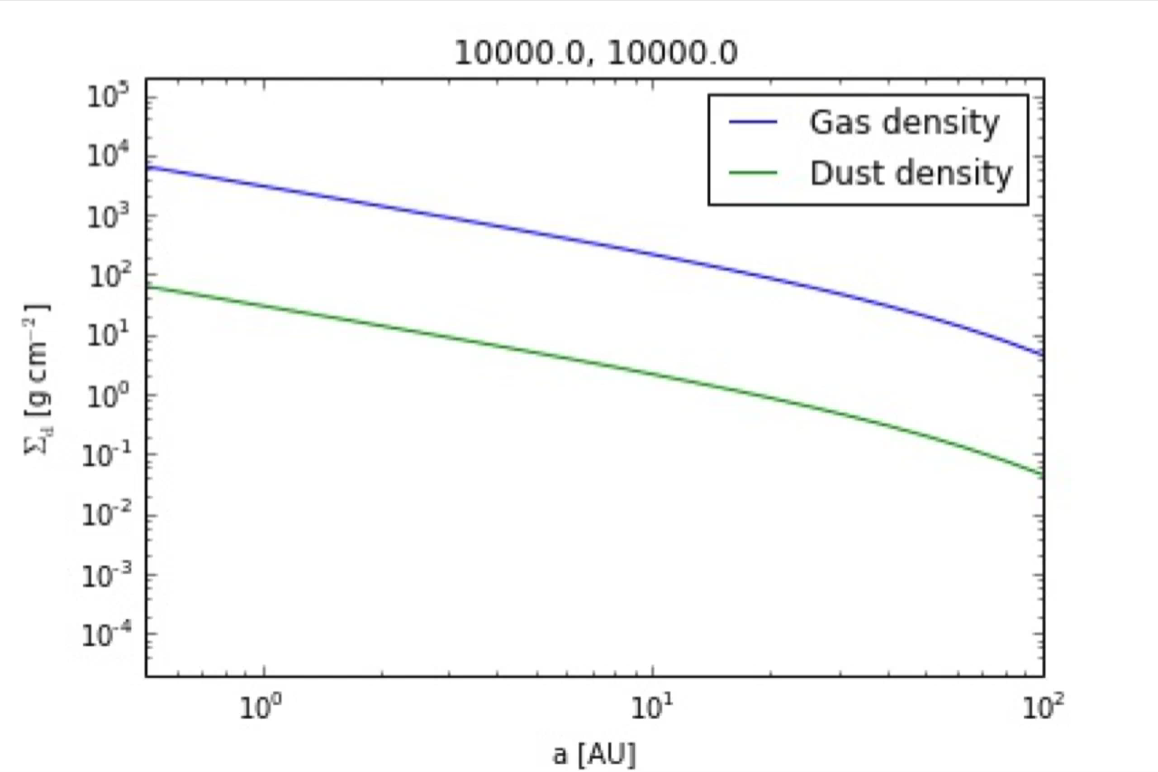
Preliminary Results 2: Determined profiles for gas and dust surface densities
s = 0.001 cm
alpha = 0.01, s = 0.001 cm

Slide 20

Preliminary Results 2: Determined profiles for gas and dust surface densities
s = 0.001 cm
alpha = 0.01, s = 1 km

Slide 21

Preliminary Results 2: Determined profiles for gas and dust surface densities
s = 0.001 cm
alpha = 0.01, s = 1 km
alpha = 0.01, s = 1 m

Slide 23
Vapor abundance in steady state disk

Slide 24
Larger disk surface density reduces M_{crit}by up to ~20%

Slide 25
N2H⁺ + CO -> HCO⁺ + N2
N2 + H2D⁺ -> N2D⁺ + H2?

Slide 26
Private defense
Show EOS plots
Show final vs initial distance plots
Show fractional mass vs distance/time plots?
Discuss time-dependent C/N/O ratios; show plot for steady state disk if it exists; show equations on how to further expand model for evolving disk

Slide 27
Core accretion sketches and intro from previous talks
Summary of model assumptions
Have delad plots
Show result for polytropic EOS, then realistic EOS, then grain growth; either show plot for grain growth with coagulation or mention that coagulation will significantly decrease Mcrit
Takeaway point: Mcrit is highly dependent on disk location and properties, and may be as low as 1 ME; have Hr 8799 plot again

Slide 28
The Role of Disk Dynamics and Ice Morphology for Snowlines and the C/N/O Ratios
Restate that disk compositions regulat planet compositions; show image of planet accreting disk material
Introductory slides with disk processes, volatile detections in disk, CO snowline, WASP 12 b C/O “detection” and show show a picture of JWST; put disk cartoon later, C/O theoretical model
Introduce the idea of Oberg+11 and show plot
We expand this model by… introductory drift slide and gas accretion slide
Show timescales plot?
Show C/O plot from Paper I
Lead with ice morphology for CO; show Edith’s plot, then C/O plot; at the end mentuon that CH4 doesn’t really matter; then go to nitrogen
But, other volatile to consider besides H2O, CO2, CO if we want to better constrain disk/planet compositions; i.e. nitrogen carriers; at the end mentuon that CH4 doesn’t really matter
Show top part of snowlines plot
Explain that nitrogen is abundant in the solar system and why it is primarily N2 (show e.g. comet abundance plot and Karin’s 2011 paper); N2 highly volatile hence N/O ratio may be more enhanced than C/O; moreover, there’s also some NH3
Snow N/O static disk plot and mention high enhancement
Snowlines are also highly dependent on ice morphology; show plot from Edith’s paper
Show N/O ratio plot (in stages) to demonstrate how disk dynamics and ice morphology affect snowline locations
Takeaway point 1: N/O ratio enhanced throughout most of the disk, more enhanced than C/O; thus could be used to a trace a planet’s formation origin
Takeaway point 2: CO and N2 snowline locations highly uncertain and can span several tens of AU due to disk dynamics and ice morphology; need observations

